Slide 1

C# Fundamentals
Course Introduction
SoftUni Team
Technical Trainers
Software University
https://softuni.bg/

Slide 2
Table of Contents
Course Objectives
Training and Team
Course Organization
Course Infrastructure
Evaluation Criteria

Slide 3
Have a Question?
sli.do
#fund-csharp

Slide 4

Course Objectives

Slide 5
C# Fundamentals Objectives
Working with linear data structures
Arrays and Lists
Defining simple classes
Processing and manipulating strings
Regular expressions
Building а simple web project

Slide 6
Practical Programming Exam
Mid Exam
3 practical problems for 4 hours
Conditional Statements and Loops
Arrays
Lists
Final Exam
3 practical problems for 4 hours
Associative Arrays
Strings and Text Processing
Regular Expressions

Slide 7
Theoretical Exam
You will have 30 minutes once you enter
Multiple choice with 1 or more correct answers
English
Automated quiz system
Available online the day before the practical exam
You can submit your answers just one time

Slide 8

The Team

Slide 9
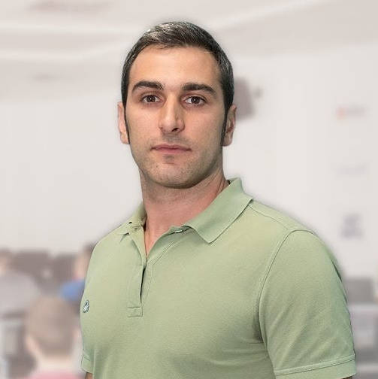

Radi Atanassov
Chief SharePoint Architect, Owner @ OneBit Software
Achieved two of highest degrees of technologie certification
Microsoft Certified Master
Microsoft Certified Solution Master
External consultant at "Office 365 Developer Patterns & Practices Core Team" at Microsoft Redmond

Slide 10
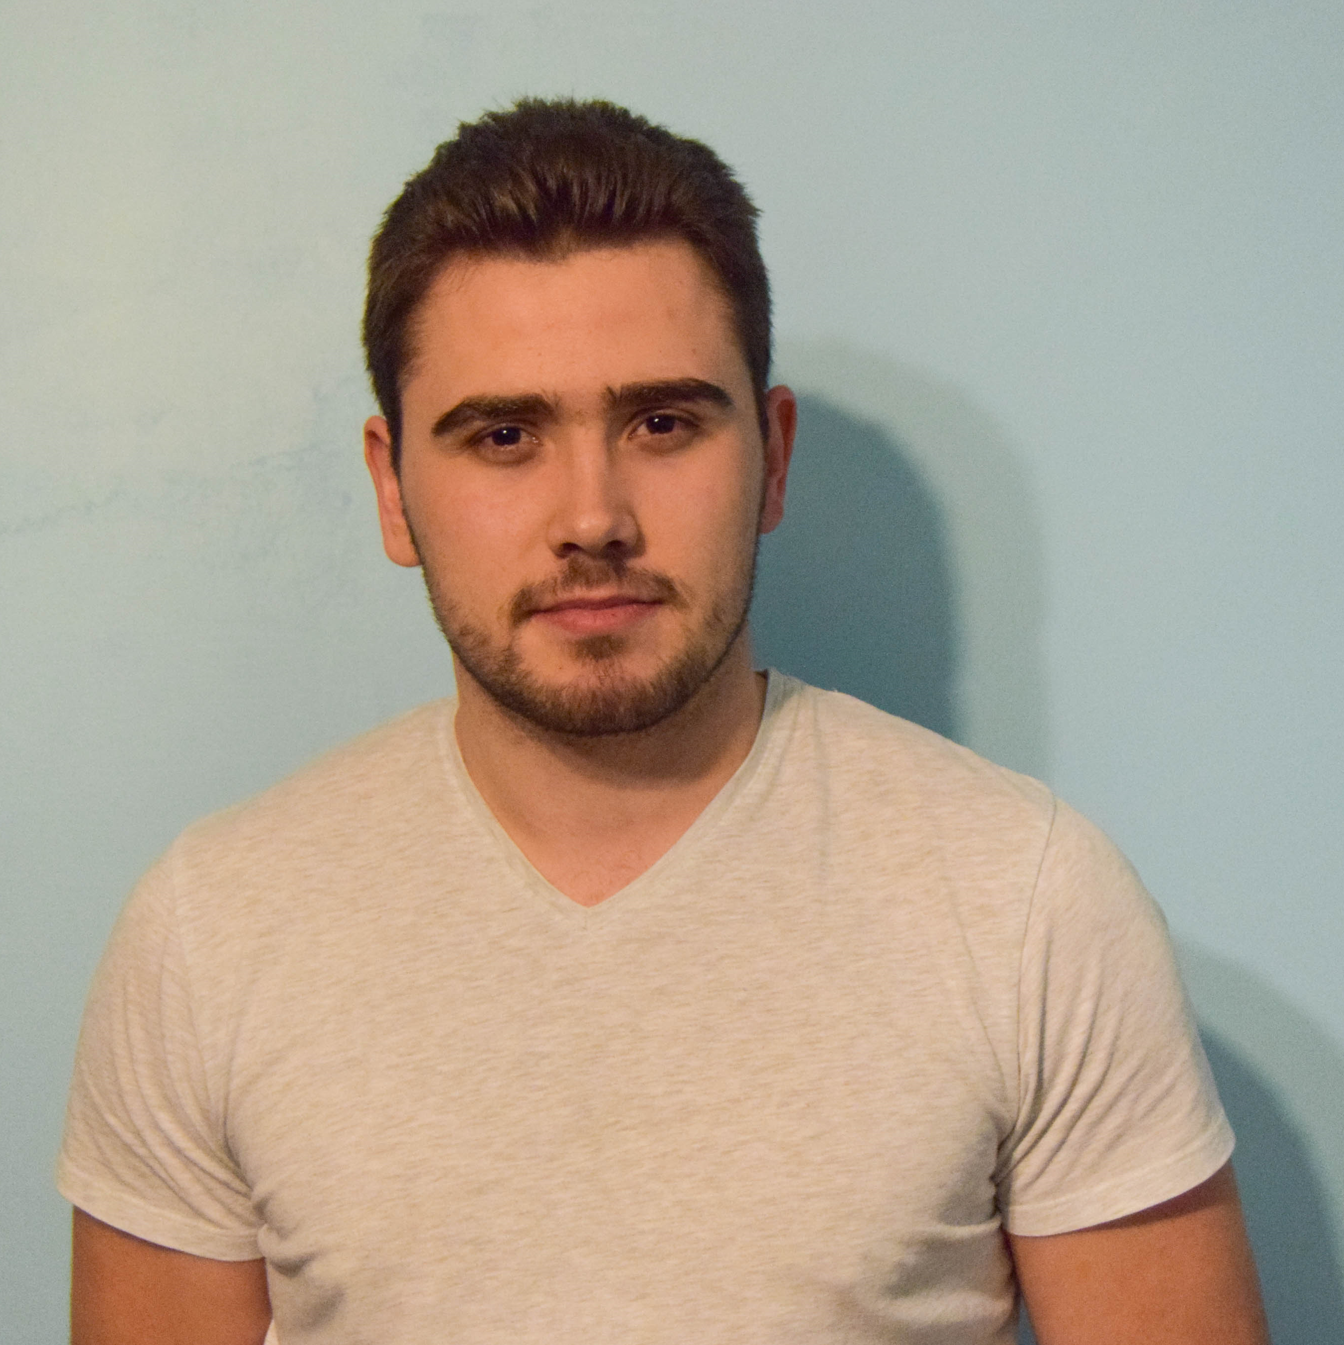
Slavi Kapsalov
Technical Trainer @ SoftUni
Graduated the C# Track
Team Lead @ SoftUni
Involved in "Projects SoftUni" – ASP.NET Core Web Project
Experience with C#, Java and PHP
Deep interests in automation of processes

Slide 11
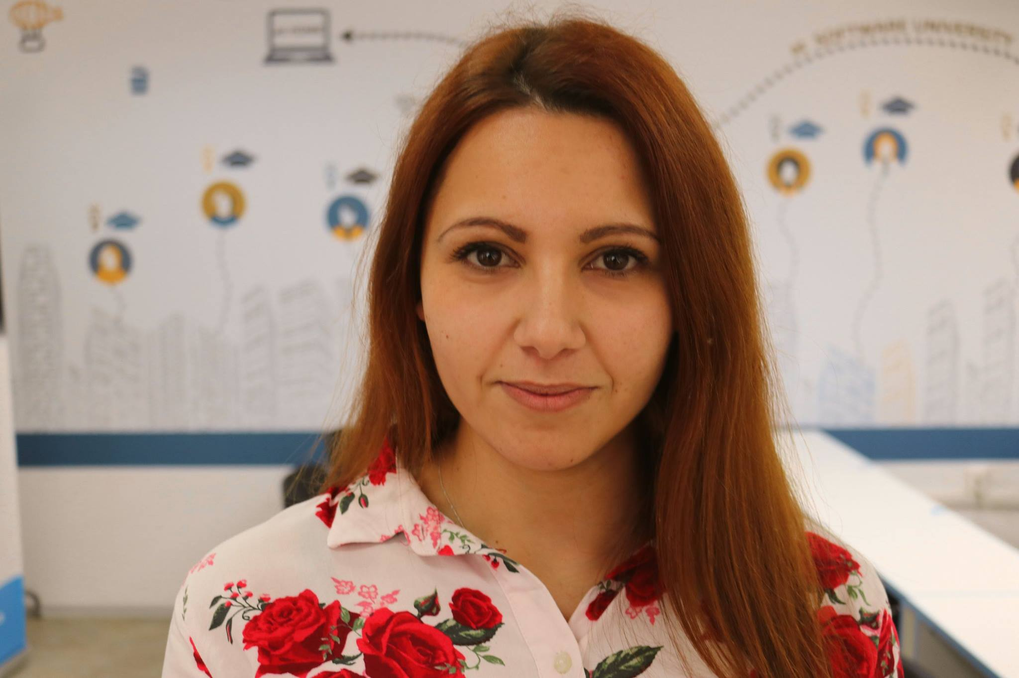
Mariela Petrova
Internship Program Manager
Technical Trainer @ SoftUni
Graduated the C# Track
Interested in web development with ASP.NET Core
Interests in Cyber Security
Contacts:
m.petrova@softuni.bg

Slide 12

Course Organization

Slide 13
C# Fundamentals Module
16-Sept-2019
2-Nov-2019
7-Dec-2019
13-Dec-2019
C# Fundamentals
12 weeks * 3 times / week
18 credits
Start: 16-Sept-2019
Mid Exam: 2-Nov-2019
Theoretical Exam: 6-Dec-2019
Final exam: 7-Dec-2019
Re-Take Exams
Mid Exam Retake: 10-Dec-2019
Тheoretical Exam: 12-Dec-2019
Final Exam Retake : 13-Dec-2019

Slide 14

Homework Assignments & Exercises
Your homework is mainly work in class
Lesson days → slides + live demos + exercises
Exercise days → only exercises
How to submit your homework?
Submitted in the judge system
Do your homework when it's due
Assignments pile up quickly

Slide 15



Scoring System for the Course
Theoretical Exam 5%
Practical Exam (Final + Mid) 90%
Presence in class 5%
Evaluation
Homework 5 %

Slide 16



Course Web Site, Forum and FB Group
Official web site:
Official discussion forum:
Official Facebook group:
Community Facebook Group
softuni.bg/trainings/2438/csharp-fundamentals
softuni.bg/forum/categories/44
facebook.com/groups/FundamentalsModuleSeptember2019/
facebook.com/groups/SoftUniCSharpCommunity/

Slide 17
https://softuni.bg/courses/technology-fundamentals

Slide 18












SoftUni Diamond Partners

Slide 19



SoftUni Organizational Partners

Slide 20




Trainings @ Software University (SoftUni)
Software University – High-Quality Education and Employment Opportunities
softuni.bg
Software University Foundation
http://softuni.foundation/
Software University @ Facebook
facebook.com/SoftwareUniversity
Software University Forums
forum.softuni.bg

Slide 21

License
This course (slides, examples, demos, videos, homework, etc.) is licensed under the "Creative Commons Attribution-NonCommercial-ShareAlike 4.0 International" license

